Slide 1

NORBECK SEWER MAIN REHABILITATION PROJECT
Project No. CI7597B23​
July 25, 2023

Slide 2
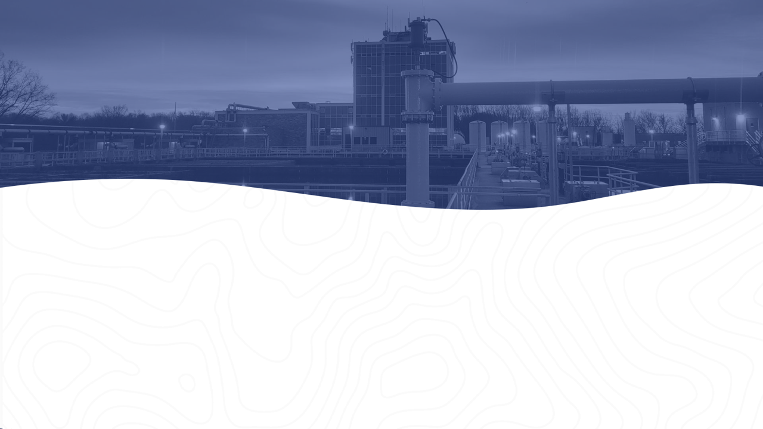
Introduction to Project Team​
Sewer Rehabilitation Program Overview​
Project Overview​
Project Map​
Sewer Rehabilitation Methods​
Estimated Construction Schedule​
What to Expect During Construction ​
Questions & Answers​

Slide 3
Project Team
Jose Fuentes, Design Project Manager​
(301) 206-8587, Jose.Fuentes@wsscwater.com
Francell Reed, Construction Manager​
(301) 206-7363, Francell.Reed@wsscwater.com​
Thomas Johnson, Project Outreach Manager
(301) 206-8542, Thomas.Johnson​@wsscwater.com
Brandon Stewart, Customer Advocate
(301) 642-1712, Brandon.Stewart​@wsscwater.com
Pleasants Construction, Inc.

Slide 4
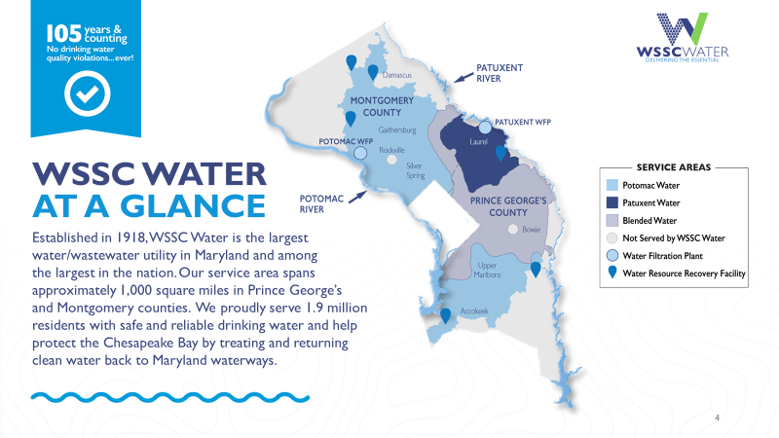

Slide 5
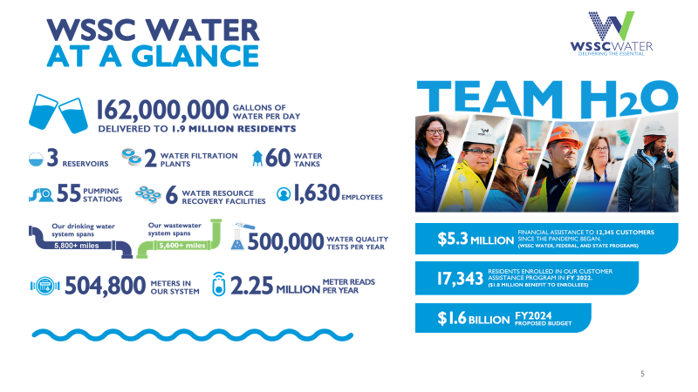

Slide 6
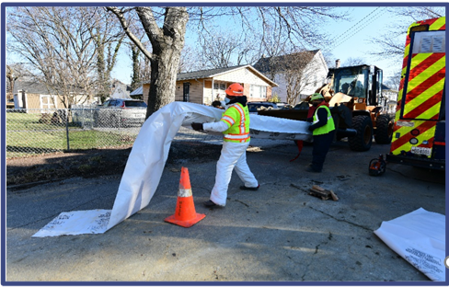
Project Overview
WSSC Water is strategically replacing and rehabilitating aging infrastructure throughout service area.
Project includes replacing approximately 1.54 miles of sewer mains and house connections to property line.
Approximately 7 manholes will be rehabilitated or replaced.
Sewer pipes and manholes rehabilitated using primary trenchless methods, however those in very poor condition will require excavation to repair and replace.
Completed project will extend life of sewer pipes by at least 50 years.

Slide 7
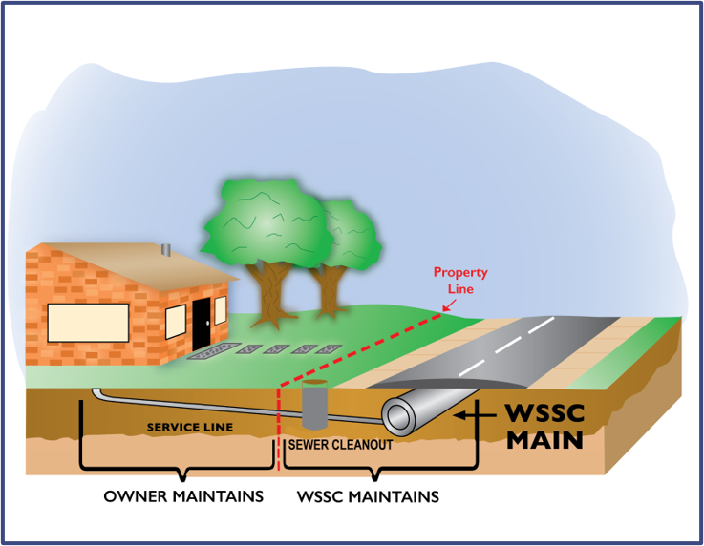
Project Overview cont.
New sewer mains installed and rehabbed within roadways.
Sewer house connections (up to the property lines) replaced and reconnected.
Replacing existing pipes provides for correcting structural deficiencies in sewer mains that may result from soil settlement, root penetration or corrosion, and often contribute to sewer overflows and backups into homes.

Slide 8
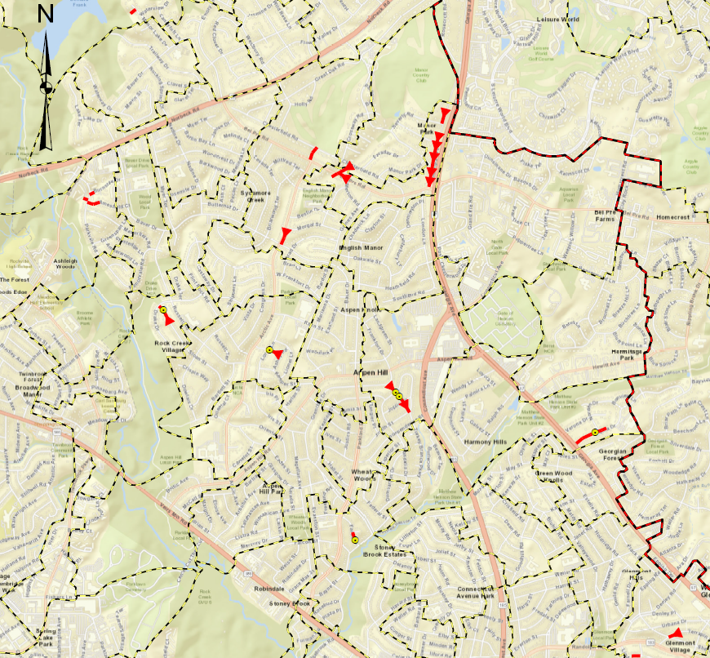
Project Map
Directly Impacted Streets
TERRAPIN RD JUDITH ST CARROLTON RD
SHERATON ST VANDALIA DR MONTPELIER RD
KENDALL ST REGINA DR MANOR LAKE DR
NEWTON ST NORDEN DR BEVERLY RD
FAROE PL AMESFIELD CT
FAROE CT PARKVALE RD
DRAKE DR GEORGIA AVE
SLOAN ST BEL PRE RD
ASHBY RD MERTON RD
GRENOBLE DR ARCTIC AVE
LOREE LN BAUER DR
JOPLIN DR MORGAL ST
CHESTERFIELD RD TURKEY BRANCH PKW

Slide 9
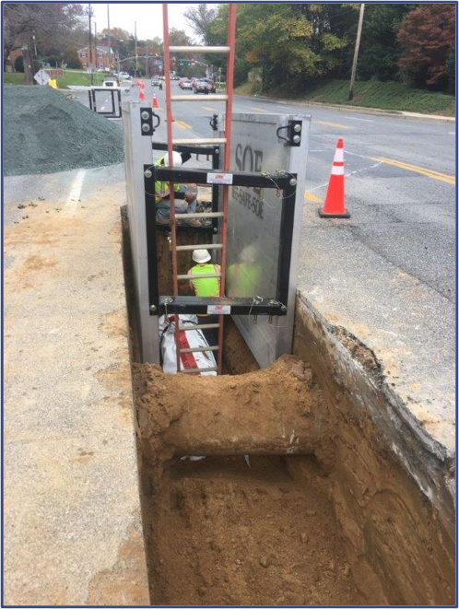
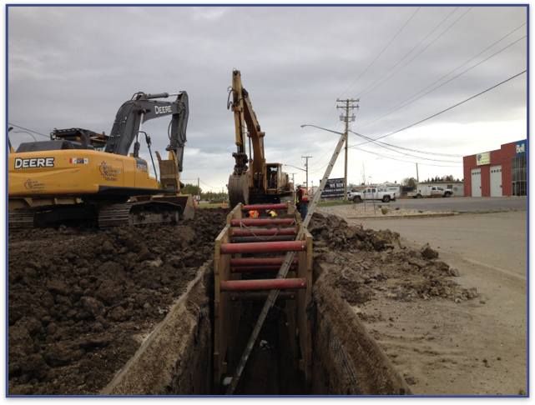
Sewer Rehabilitation Method:
Open Trench

Slide 10
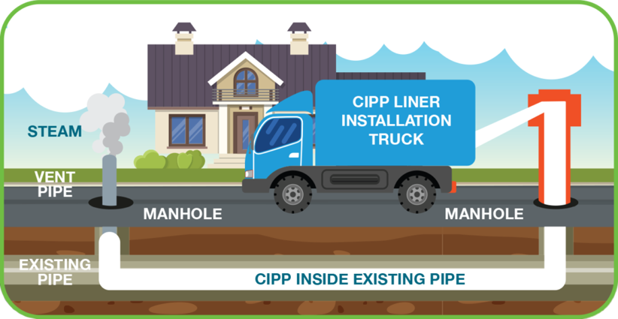
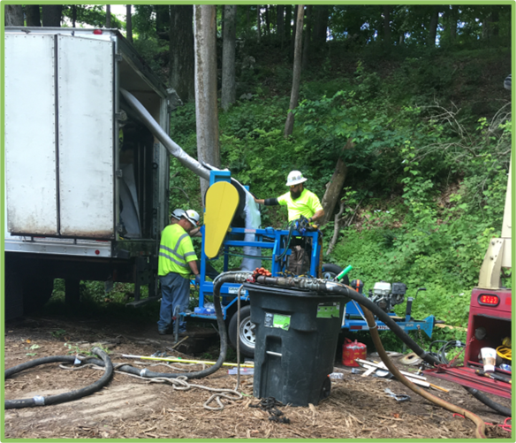
Sewer Rehabilitation Method: Pipe Lining

Slide 11
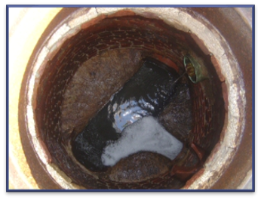
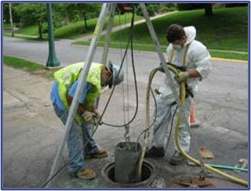
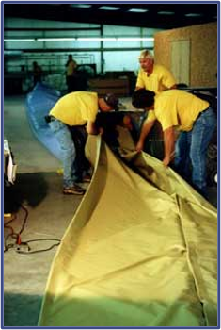
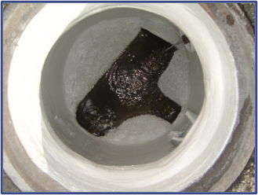
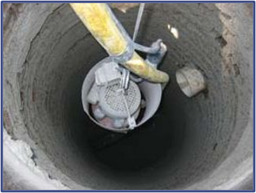
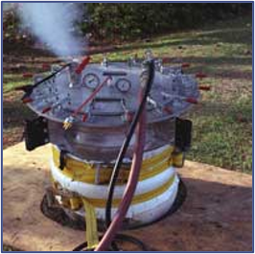
Manhole Rehabilitation

Slide 12
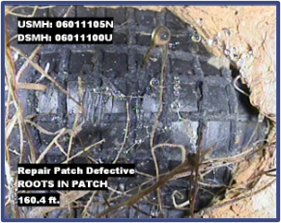

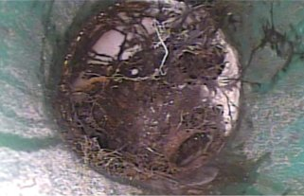
Tree Removal and Pruning
Per the Department of Natural Resources Maryland Forest Service Public Agency Tree Maintenance Permit, construction methods that minimize tree impacts must be examined.
Prior to final decision to remove a tree, WSSC Water
considers the following factors: ​
  Size, species and structural condition of the tree​
  Impact tree will have on utility assets​
  Feasibility of relocating infrastructure or using trenchless methods​
WSSC Water Urban Forester supervises all tree removal and pruning.
Pipes and Trees
Do not Mix!

Slide 13

Estimated Construction Schedule
Expected Construction Start Date: Fall 2023
  (Pending Permit Acquisition)​
Estimated Construction Duration: 12 Months​
​
Expected Construction Finish Date: Fall 2024
(Weather Permitting)​
Construction schedules are estimated and weather permitting​

Slide 14

What to Expect During Construction
Anticipated Work schedule: 9:00 a.m. to 3:30 p.m., Monday-Friday​
  Conditions at some locations may require different work hours​
  Residents notified at least two days prior to all construction activities​
Construction activities may include:​
  Marking locations of utilities​
  Field inspections​
  Rehabilitation of sewer mains, manholes and laterals​
  Pavement restoration where digging is necessary​
WSSC Water coordinates with local and state agencies, as well as other utilities for all planned work to avoid potential conflict and minimize disturbances to neighborhoods.

Slide 15
What to Expect During Construction cont.
Reliable sewer service will be maintained during construction.
Street parking will be limited on streets with active construction:
  48-hours advanced notification will be provided
  NO PARKING signs will be posted ​
  All roads will remain accessible at all times during construction; however, certain activities may require temporary closures and delays​
Access from the public roadway to businesses and homes will be maintained at all times.​
Entry into homes is NOT required.​

Slide 16
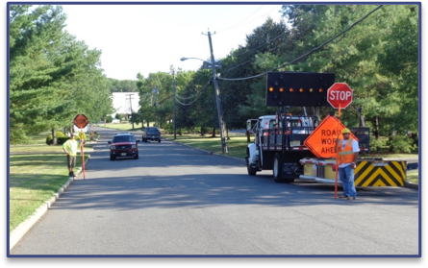
Traffic Impacts
Certain construction activities may require temporary changes to traffic patterns​:
  Traffic will be managed to minimize community disruptions​
Access to homes maintained during construction​:
  Access into homes is NOT required​
  Access onto private property is generally NOT required​
Parking restrictions:
  WSSC Water will provide 48-hour advance notice (denoted by “No Parking” signs) prior to any parking restrictions​
  Any vehicles not been removed from the designated area will be towed to a nearby street at no cost to owner
  Final restoration of sidewalks, roadways and landscaping will take place within 90 days of construction completion ​

Slide 17




Contact WSSC Water
Customer Service | Monday-Friday, 8:00 a.m. to 6:00 p.m.​
Phone: 301.206.4001 | 1.800.634.8400 ​
Email: customerservice@wsscwater.com​
24-Hour Emergency Call Center ​
Water Emergency, Sewer Emergency or Discolored Water​
Phone: 301.206.4002 | Email: emergencycallcenter@wsscwater.com ​
Report a Problem: wsscwater.com/customer-service/report-problem​
Discolored Water: wsscwater.com/discoloredwater ​​
File a Claim ​
Phone: 301.206.7095 ​
Online: wsscwater.com/claims​
​
WSSC Water Financial Assistance Programs​
Online: https://www.wsscwater.com/assistance​
Customer Notification System Sign-Up ​
Online: www.wsscwater.com/cns, email and/or text alerts on work in your neighborhood ​

Slide 18


